Slide 1

Forms Comparison Tool
TOOL DESCRIPTION
This tool helps to compare the components between PROD and lower region and list new/deleted components in a html page. It also compare the contents of modified components and highlight the changes in an html page for each component
BENEFITS
This tool can be used effectively during Code reviews. This can assist the peer reviewer.
Improves Productivity.
This tool comes handy during code collisions.
Have Demo?
Yes
Current Status
Active
CCM PRODUCT
DOCUMAKER
OFFERING
COMPONENT COMPARISON
ACCOUNT NAME
METLIFE
EFFORT SAVINGS(Person Hours/Per Year)
378hrs
COST SAVINGS (Per Year)
(30% of Code Review Effort Saved)*
$7000
Future Plans
Integrate with the content only deploy Tool, which ensures auto promotion after comparison.
*Assumptions:
20 Projects per month.
Efforts for code review -10 days/Month
Efforts After- 6.5 days/Month
Projected $Value -$575(Offshore Value)

Slide 2
DM – Forms Comparison Tool

Slide 3
Overview Of The Tool
To compare the components between PROD and lower region and list new/deleted components in a html page and in excel sheet
To compare the contents of modified component and highlight the changes in html for each component. It also creates an Excel sheet with modified changes.
User friendly interface to generate the report through IE browser
The tool has been Integrated with Existing Forms Analysis Tool

Slide 4
How to Use ?
Open the below link in Internet Explorer
\\CTSC00586316701\share\Tools repository\Documaker\FACT (Forms Analysis and ComparisonTool)\Forms Analysis & Comparison Tool\index.html
Go to Read me / Set Up tab and click “Create Working Folders”
A pop up window will open up ,Click on Run bat file
The necessary folder structure for the tool will be created automatically
Demo Video can be found in Demo Tab
Note: Please Use Internet Explorer only. Chrome is not supported.

Slide 5
How to do Compare?
Filter all the production components(BDF, FOR, FAP, DAL, XDD and LOG) with last version and last revision and extract it to folder - D:/Forms Analysis Tool/input/formcomparison/Prod-Components/
Filter all latest prod ready components (BDF, FOR, FAP, DAL, XDD and LOG) and extract it to folder –
D:/Forms Analysis Tool/input/formcomparison/QA-Components/
Click on Generate Report button
The Report will be generated in output path
D:/Forms Analysis & Comparison Tool/output/formcomparison/
FormCamparisonReport.html
modified_components.html
Forms Comparison.xls

Slide 6
DEMO

Slide 7
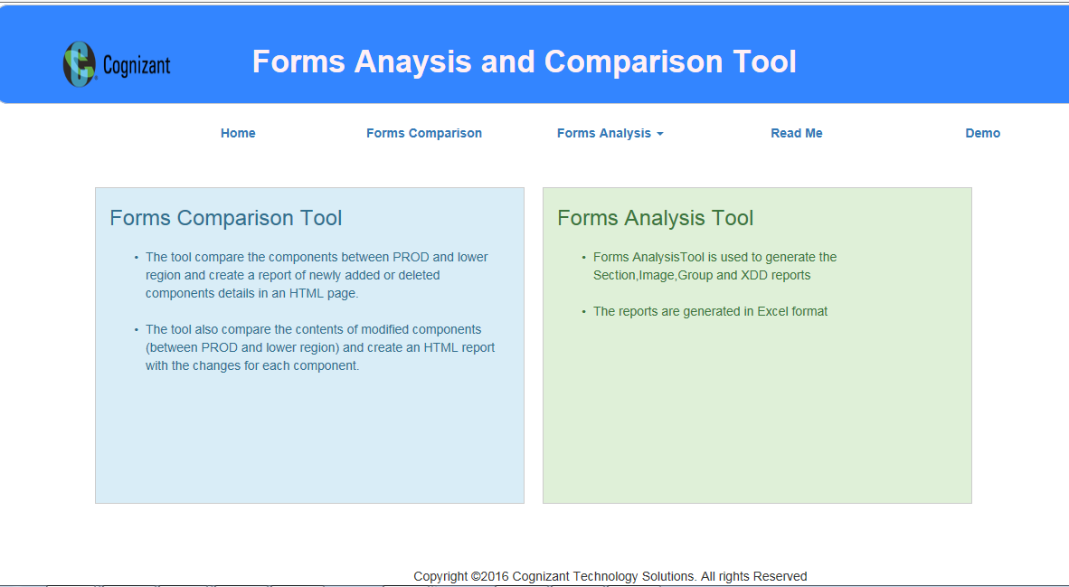

Slide 8
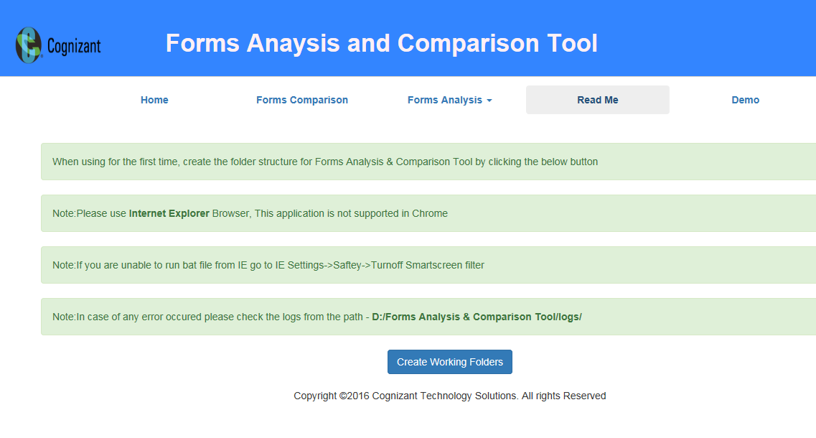

Slide 9
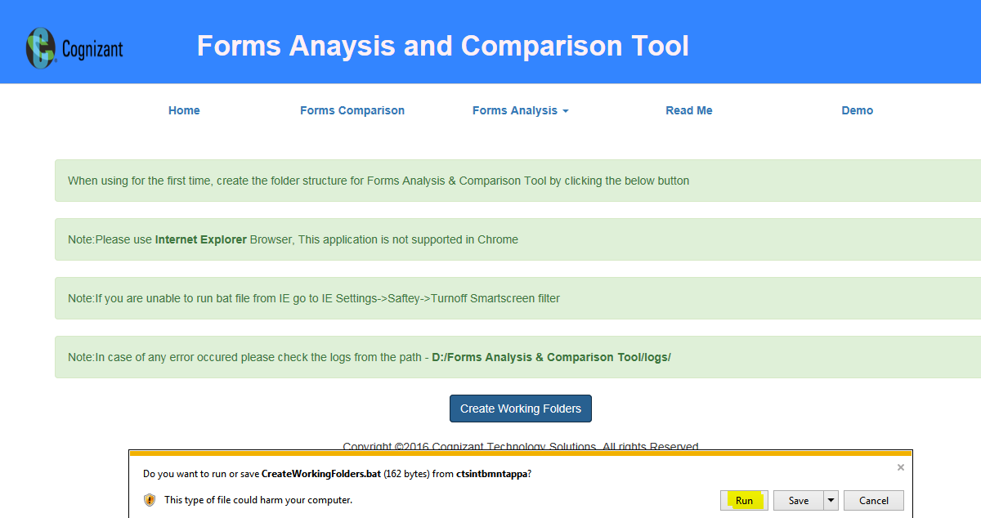

Slide 10
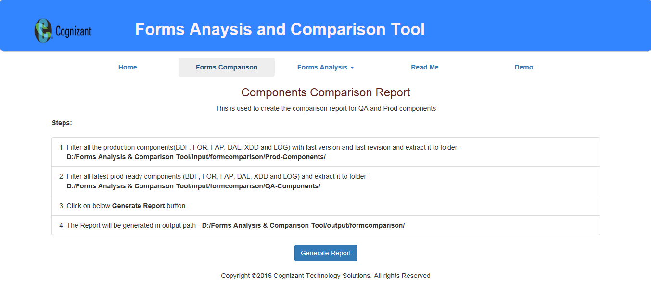

Slide 11
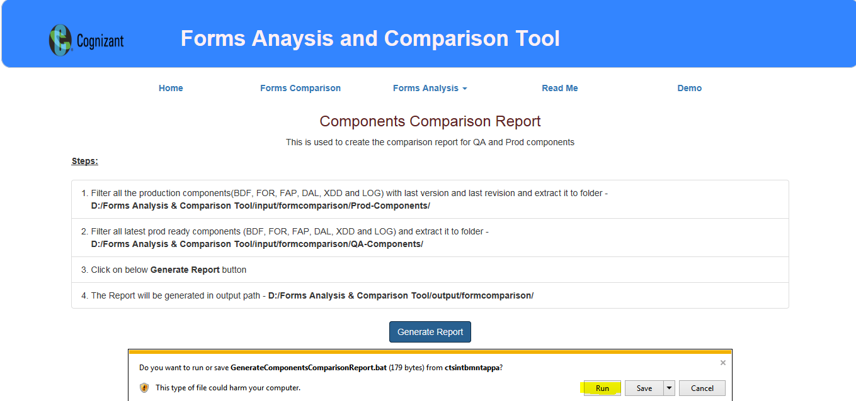

Slide 12
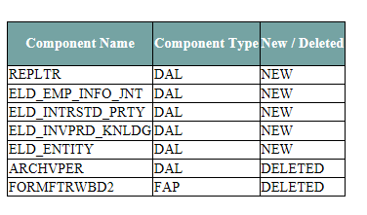
New-Deleted Components HTML page

Slide 13
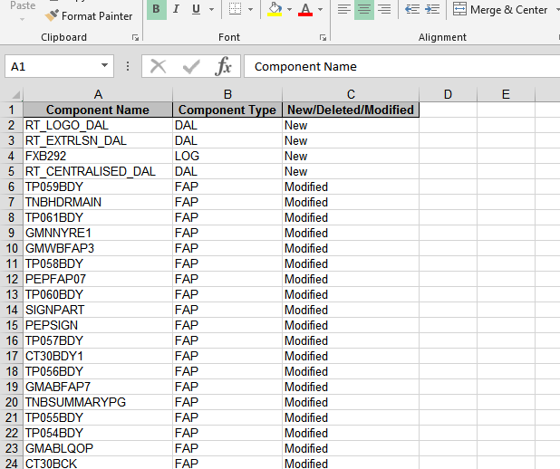
New-Deleted Components Excel Sheet

Slide 14
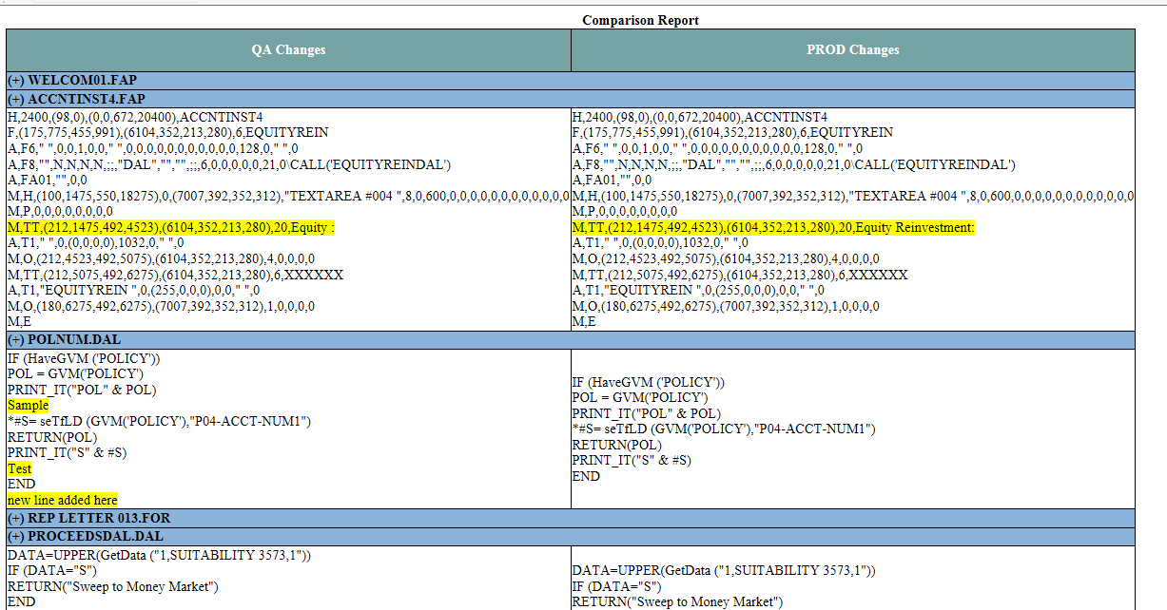
Modified Components in HTML page

Slide 15
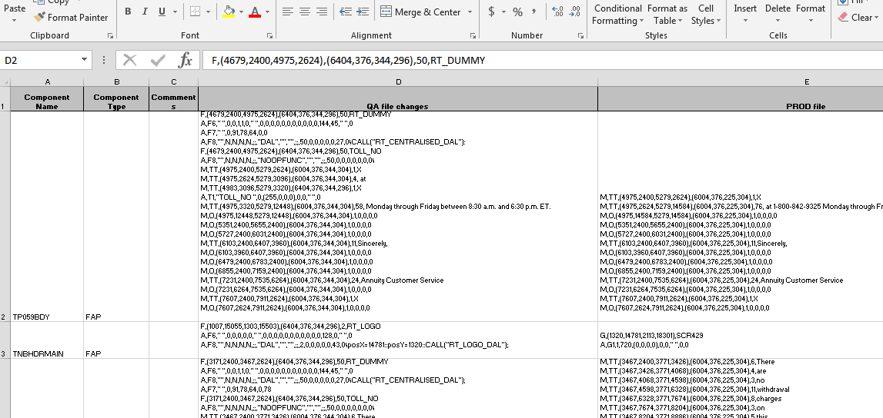
Modified Components sheet

Slide 16
Thank You

